Slide 1
Welcome to
Day 3 of
Applications of Basic Python and its Libraries
An Outcome Based ‘Three-Day Online Workshop’
by
ECE | VVIT

Slide 2
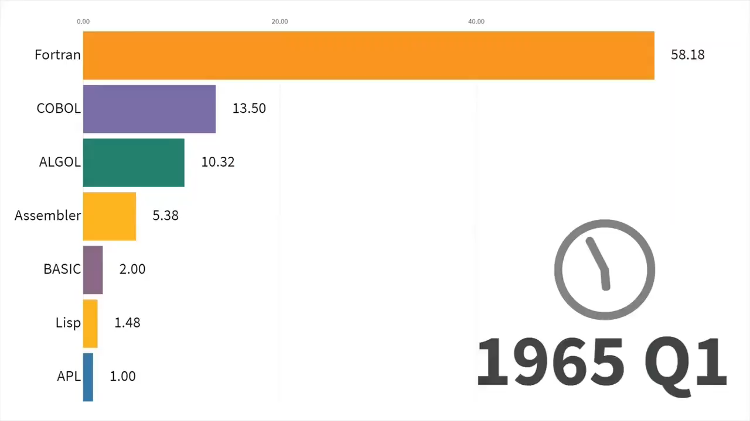
Agenda
Generation and Real-Time Detection of QR codes
Some discussion on python ‘re’ library
Project discussion

Slide 3
Agenda
Generation and Real-Time Detection of QR codes
Some discussion on python ‘re’ library
Project discussion
Notes:
Welcome to this last session. This session is on “QR codes – Generation and Detection using Python”

Slide 4
Agenda
Generation and Real-Time Detection of QR codes
Some discussion on python ‘re’ library
Project discussion
Generation and Real-Time Detection
Of QR Codes using Python
Notes:
Welcome to this last session. This session is on “QR codes – Generation and Detection using Python”

Slide 5
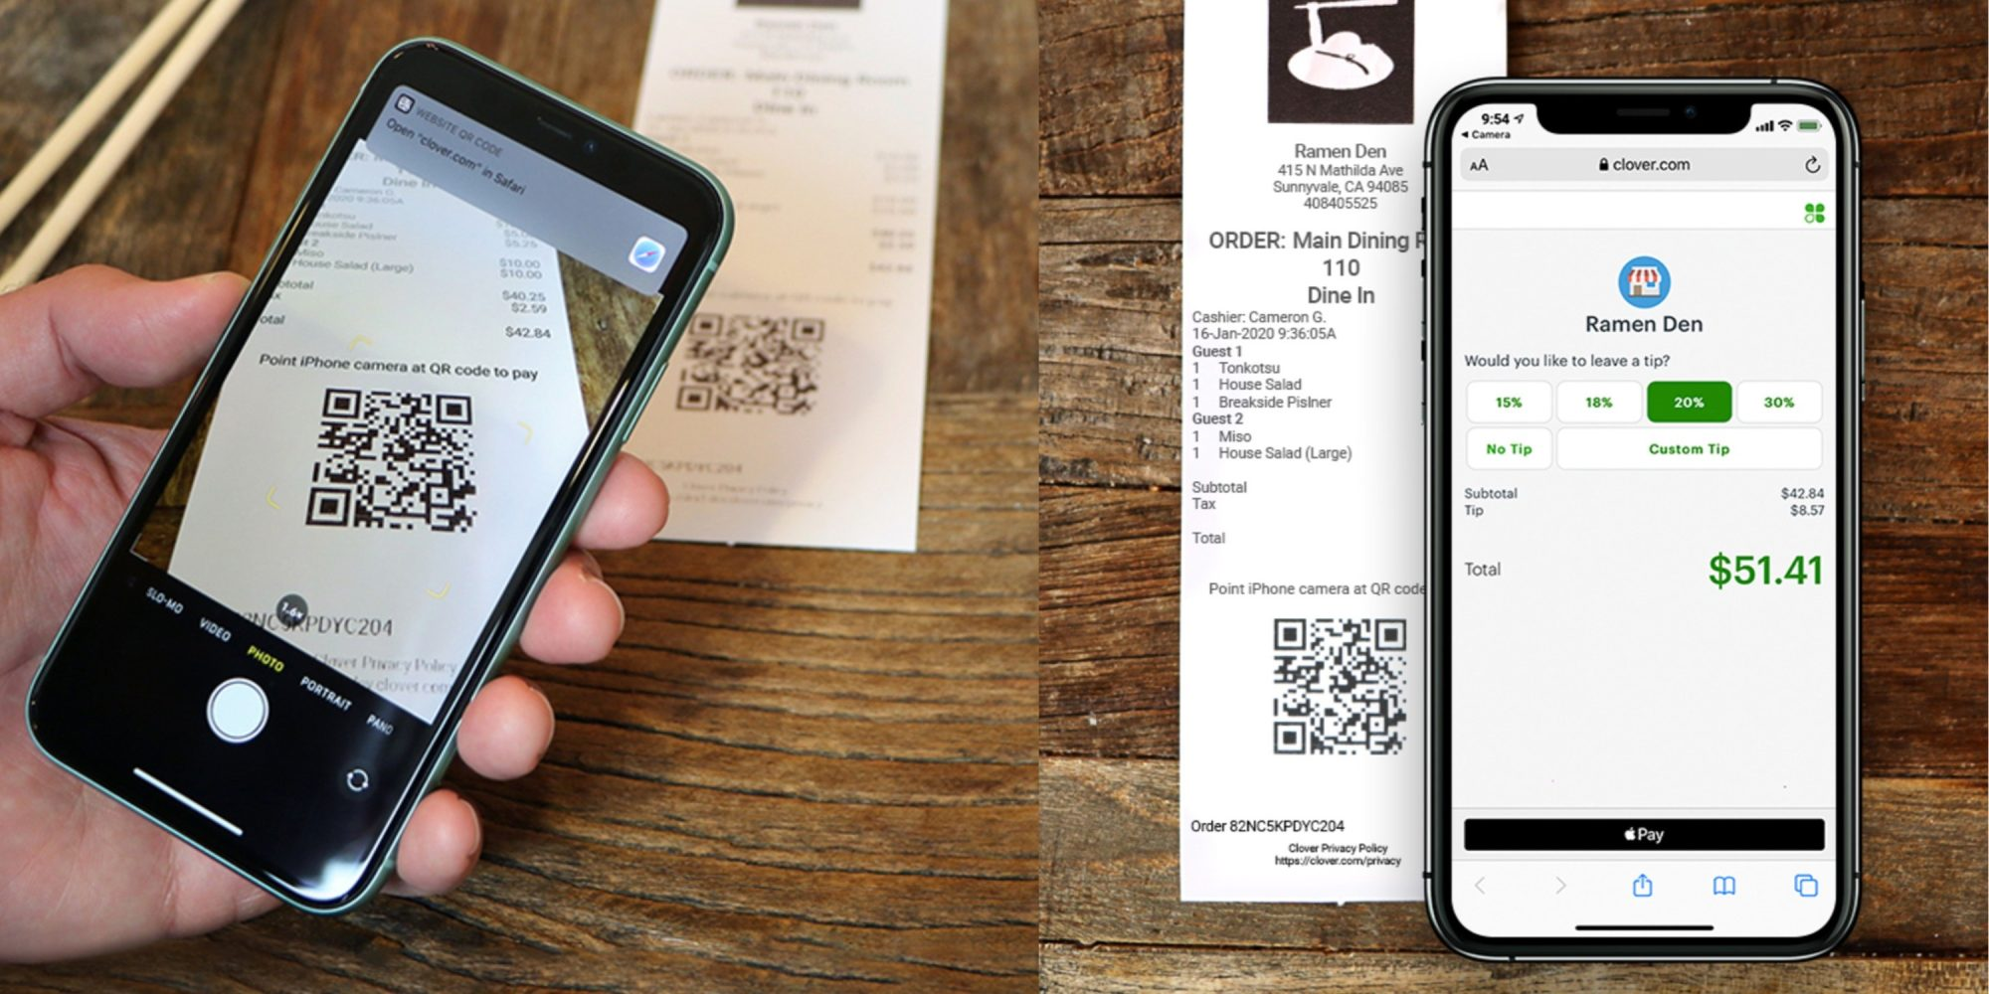
Applications # 1
Notes:
I had a little bit interest in the bar codes and qr codes as we find them every where
First of all, let us see few of its applications
Digitization has revolutionized the world by digital payments
Now a days it has become more easy because of mobile payment apps
We scan the qr code and do the payment

Slide 6
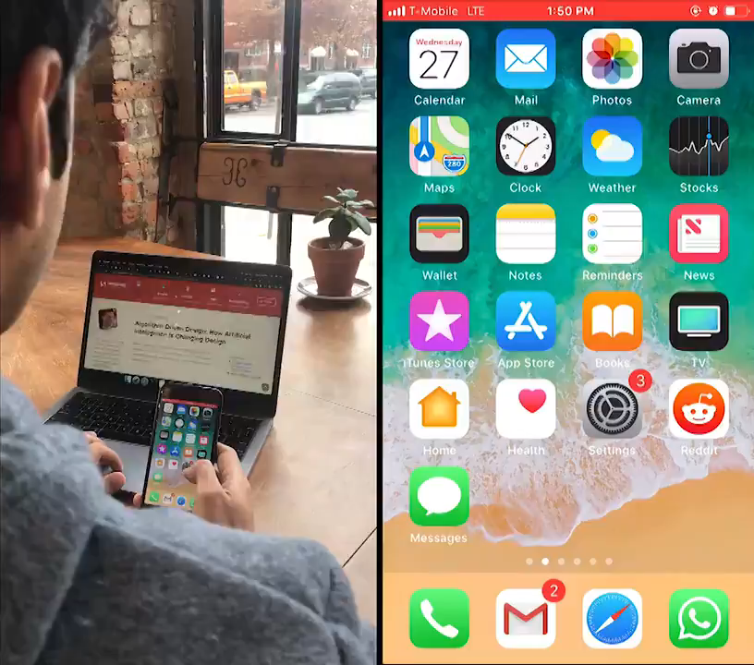
Applications # 2
Sometimes when we step away from laptop we want to continue reading the article we had open… but on our phone instead.
So https://shek.it/ built a chrome extension that lets us easily do that.

Slide 7
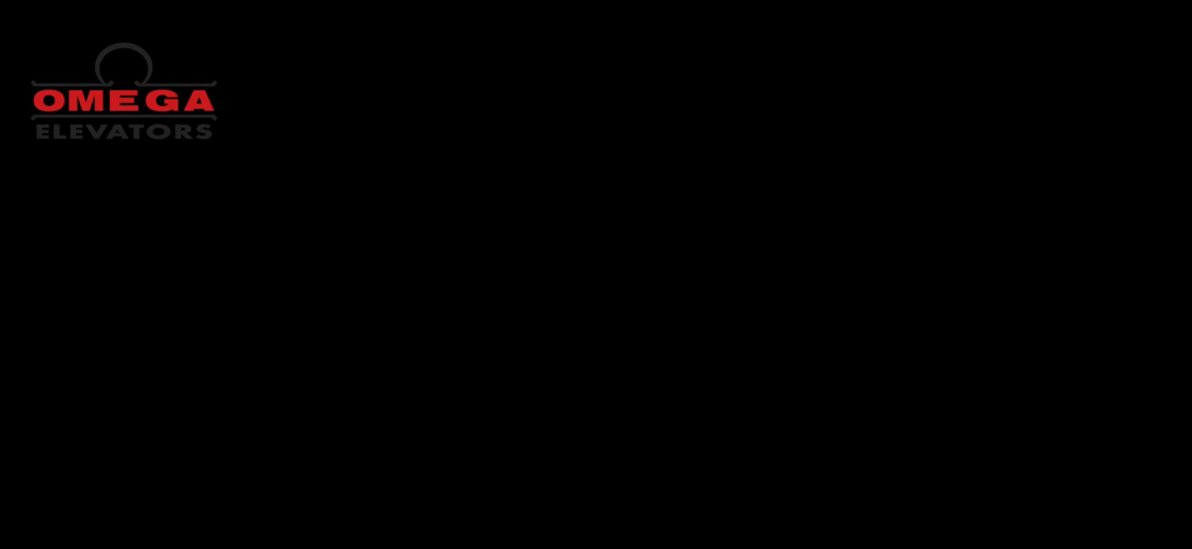
Applications # 3

Slide 8
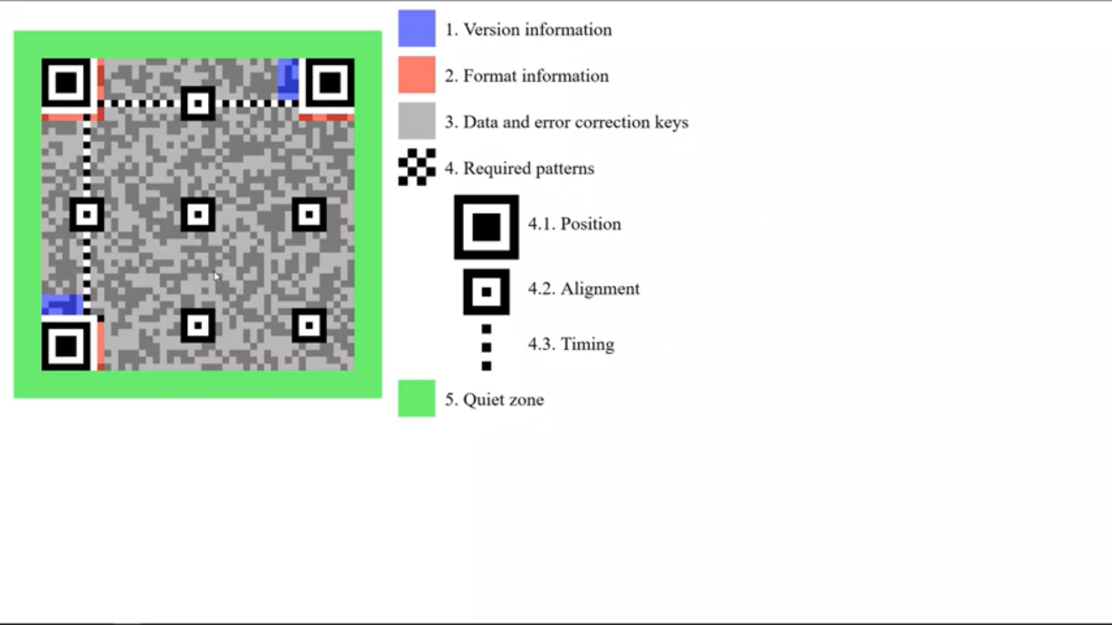
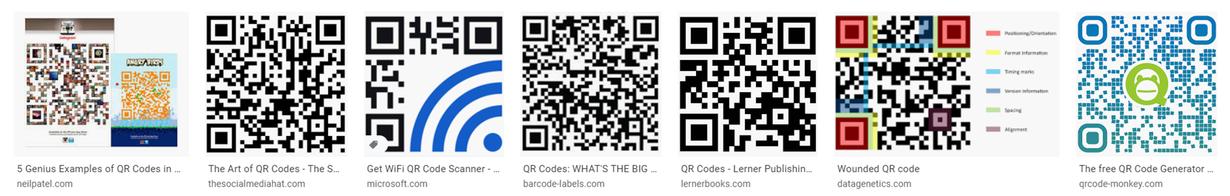
What are QR codes?
QR codes are images that are printed / stickered / displayed around almost every where
They act as Quick Response codes – making our life easy in these days
1. Version control
5. Quite Zone
2. Format Information
3. Data and error correction keys
4. Required Pattern
Refer wiki for more information
https://en.wikipedia.org/wiki/QR_code
4.1. Position
4.2. Alignment
4.3. Timing

Slide 9
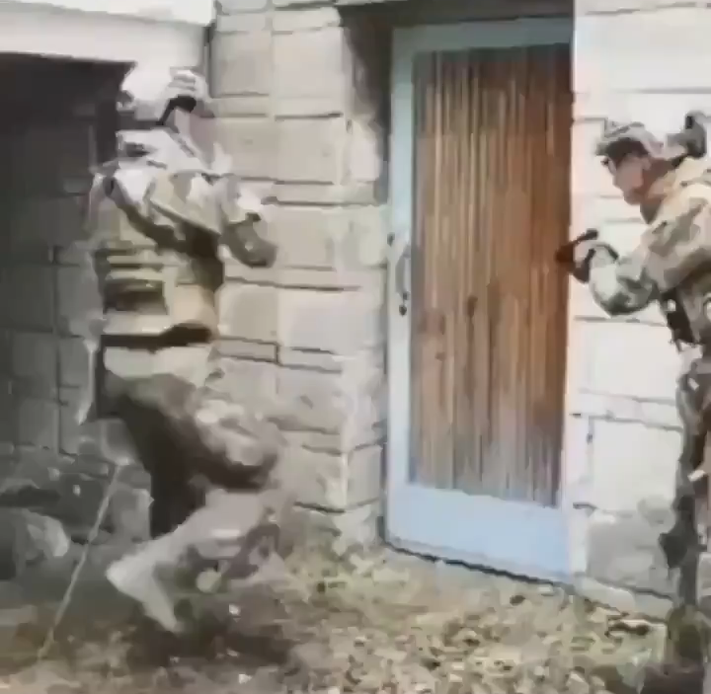
What information these QR codes actually contain?
Usually some textual information
Names, addresses, Phone numbers, email ids, Bank account numbers, etc.
How to create / encode / encrypt QR codes?
How to read / decode / decrypt QR codes?
Well there are several Apps / websites available
But we want to do it programmable way using python
Python dependencies and versions we are going to use:
Python: 3.6.7
segno: 1.0.0
OpenCV: 3.4.4
numpy: 1.13.3
pyzbar: 0.1.8
Matplotlib: 3.0.2
re: 2.2.1
Don’t struggle to write a function to do something menial in python
There could already be a package for it
Let us start

Slide 10
Agenda
Generation and Detection of QR codes
Some discussion on python ‘re’ library
Project discussion
TASK # 01: Find how many times the word ‘email’ (irrespective of case) has appeared in the text
"EMAIL" invention controversy
Ayyadurai makes the widely disputed claim to be the "inventor of email". His claim is based on the software he wrote as a 14-year-old student at Livingston High School in New Jersey. In 1979—some sources say 1978—he wrote an implementation of an interoffice email system, which he called EMAIL.[5][6]
A November 2011 Time Techland interview by Doug Aamoth, entitled "The Man Who Invented Email", argued that EMAIL represented the birth of email "as we currently know it". In that interview, Ayyadurai recalled that Les Michelson, the former particle scientist at Brookhaven National Labs who assigned Ayyadurai the project, had the idea of creating an electronic mail system that uses the header conventions of a hardcopy memorandum. Ayyadurai recalled Michelson as saying: "Your job is to convert that into an electronic format. Nobody's …………
results = re.findall(r'email',text)
count = len(results)
print('Number of times email appeared: ', count)

Slide 11
Agenda
Generation and Detection of QR codes
Some discussion on python ‘re’ library
Project discussion
TASK # 02: Find the citations appeared in the text
"EMAIL" invention controversy
Ayyadurai makes the widely disputed claim to be the "inventor of email". His claim is based on the software he wrote as a 14-year-old student at Livingston High School in New Jersey. In 1979—some sources say 1978—he wrote an implementation of an interoffice email system, which he called EMAIL.[5][6]
A November 2011 Time Techland interview by Doug Aamoth, entitled "The Man Who Invented Email", argued that EMAIL represented the birth of email "as we currently know it". In that interview, Ayyadurai recalled that Les Michelson, the former particle scientist at Brookhaven National Labs who assigned Ayyadurai the project, had the idea of creating an electronic mail system that uses the header conventions of a hardcopy memorandum. Ayyadurai recalled Michelson as saying: "Your job is to convert that into an electronic format. Nobody's …………
citations = re.findall("\[[0-9]*\]", text)
print(citations)

Slide 12
Agenda
Generation and Detection of QR codes
Some discussion on python ‘re’ library
Project discussion
PROJECT ASSIGNMENT: Find all the email ids appeared in the text
You have to write a regular expression to extract all types of email ids from the above text
This is to inform you all that my new email is ekoprasetyo.crb@outlook.com thanks...
Mr. Moulana db.maulana@gmail.com is oppointed as manager who will be assisted by dee.wien@yahoo.com and
deninainggolan@yahoo.co.id as Senior Quantity Surveyors
Fajar.rohita@hotmail.com, was shifted to North-Eastren office
firmansyah1404@gmail.com says its time to show our metal
Our chief accounting officer fransiscajw@gmail.com says
Hi Cindy ...pls share the Salary guide to donny_tri_wardono@yahoo.co.id thank you da
# TO DO: Write a regular expression to find # email ids of any kind
email_pattern =
# Extract the email ids based on your regular # expression and display those list of #extracted email ids
emails = re.findall(email_pattern, emailtext)
print(emails)
OUTPUT
['ekoprasetyo.crb@outlook.com', 'db.maulana@gmail.com', 'dee.wien@yahoo.com', 'deninainggolan@yahoo.co.id', 'ajar.rohita@hotmail.com', 'firmansyah1404@gmail.com', 'fransiscajw@gmail.com', 'donny_tri_wardono@yahoo.co.id']

Slide 13
Thank You

